Slide 1
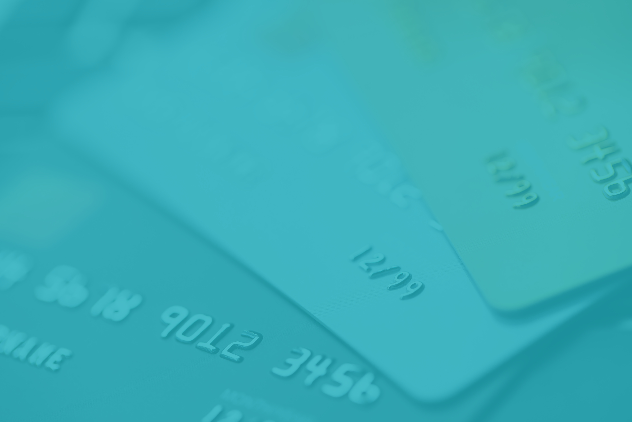



Credit Card Fraud Analysis using SQL & Excel

Slide 2
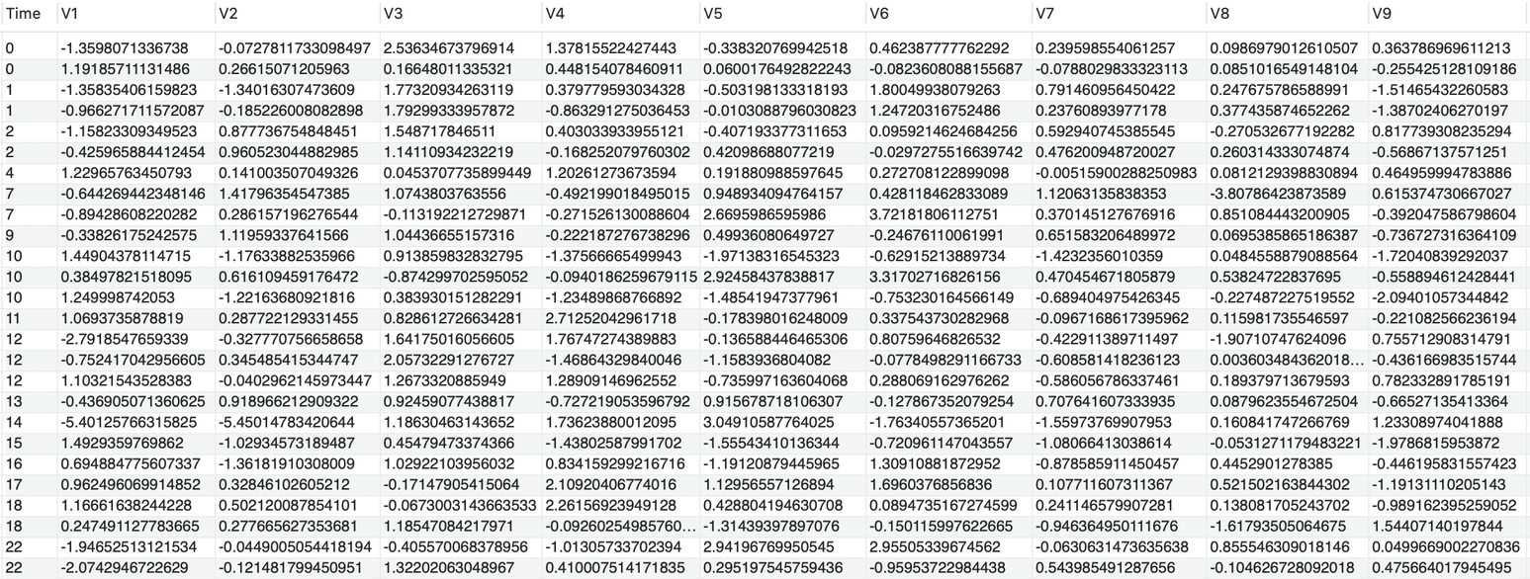
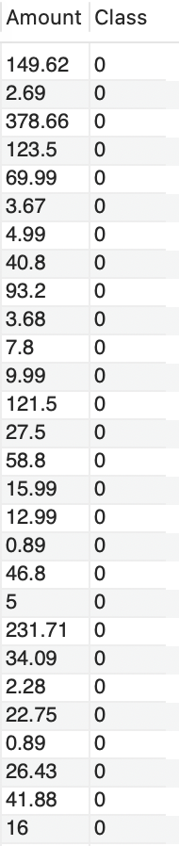
Dataset

Slide 3
Problem Statement
Credit card fraud is a major challenge for banks and customers.
Our goal is to detect fraud patterns using SQL and visualize results in Excel

Slide 4

Fraud Overview (KPIs)
Total Transactions
Fraud Transactions
Fraud Rate
284807
492
0.17%
Out of all transactions, only a tiny fraction are fraudulent (e.g., 0.17%).
However, even with this small share, fraud still represents a significant risk.
Fraudulent activity is rare but highly disruptive, making detection difficult.

Slide 5

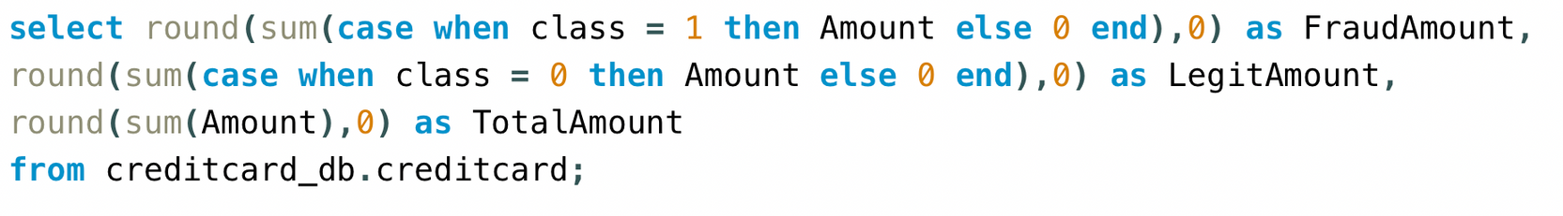
Value Lost to Fraud
Total Amount
₹25,162,590
Legit Amount
₹25,102,462
Fraud Amount
₹60,128
Out of 25.16 million total transaction value, only 60,128 (≈0.24%) came from fraud.
4
Even though fraud accounts for less than 1%, it represents a significant financial risk.
This shows that fraud is rare but costly, making early detection very important.

Slide 6
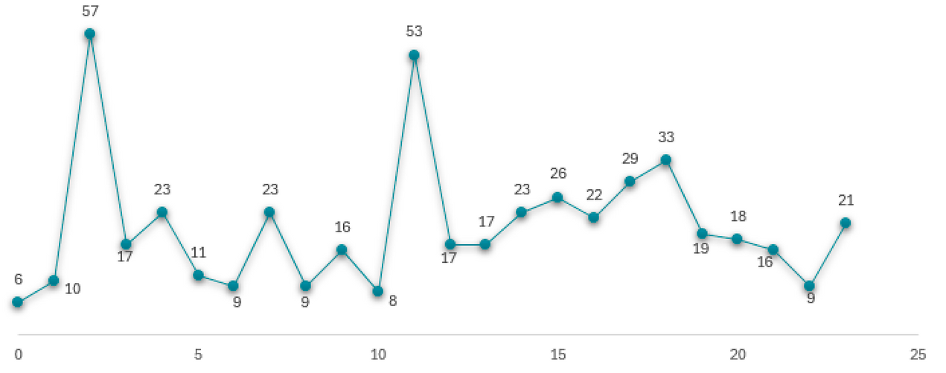



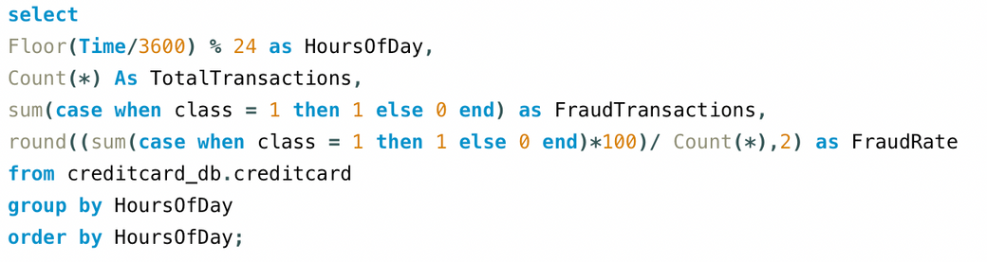
Fraud Trend over Time(Hours)
Fraud is not spread equally across the day.
The biggest spikes happen at 2 AM (57 frauds) and 11 AM (53 frauds).
Most other hours have less than 25 frauds.
This means fraudsters may be choosing specific times when they think detection is weak.
These “peak hours” should get extra monitoring and security checks.

Slide 7
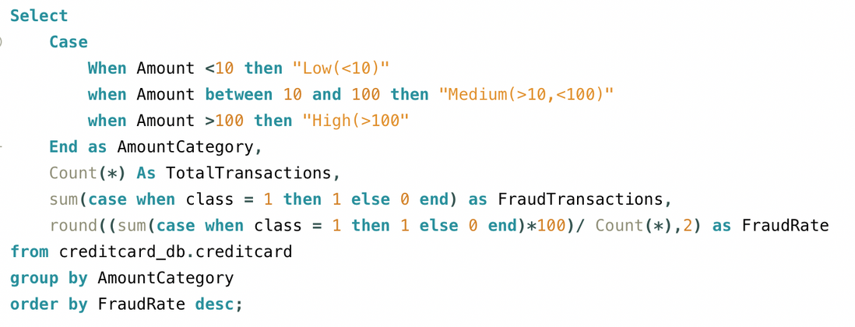
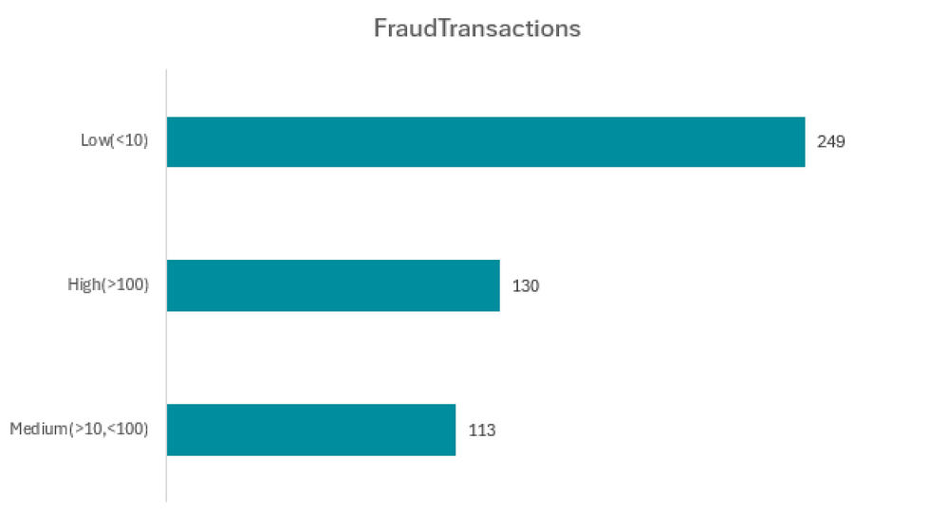
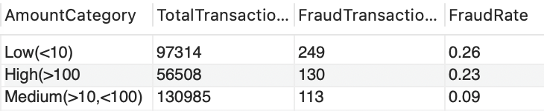
Fraud by Transaction Amount Category
Most fraud happens in low-value transactions (<10) – even though each fraud is small, they are frequent.
High-value transactions (>100) also show a high fraud rate, meaning fraudsters target big amounts too.
Medium-value transactions (10–100) are the safest, with the lowest fraud rate.
This means fraudsters try both ends – many small frauds to stay unnoticed, and some big frauds to get higher money.

Slide 8

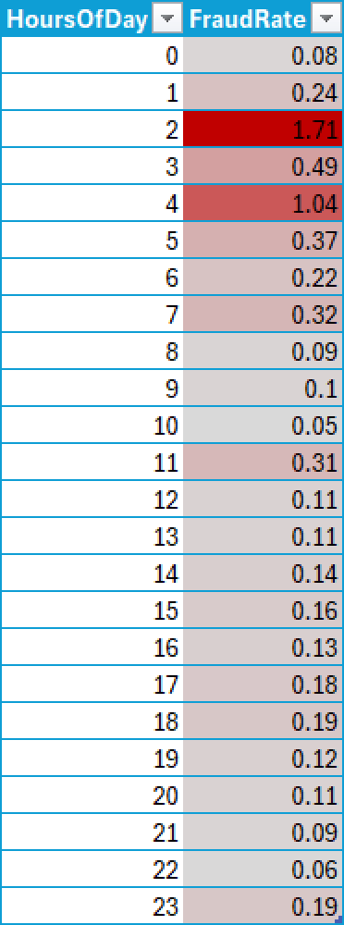
Fraud Heatmap by Hour of Day
Fraud risk is highest at 2 AM (1.71%) and 4 AM (1.04%).
There is also a moderate peak at 3 AM (0.49%) and 1 AM (0.24%).
Fraud rates are lowest during daytime hours (10 AM – 5 PM), mostly staying below 0.2%
1
Evening and night hours (6 PM – 11 PM) show slightly higher fraud rates (0.18%–0.19%) than daytime, but still much lower than early morning.
2
3
Overall, fraud is more common late at night and early morning, especially between 1 AM – 4 AM.
Actionable takeaway: Fraud detection systems should pay closer attention to transactions happening between 1 AM and 4 AM, as these hours carry the highest fraud risk

Slide 9
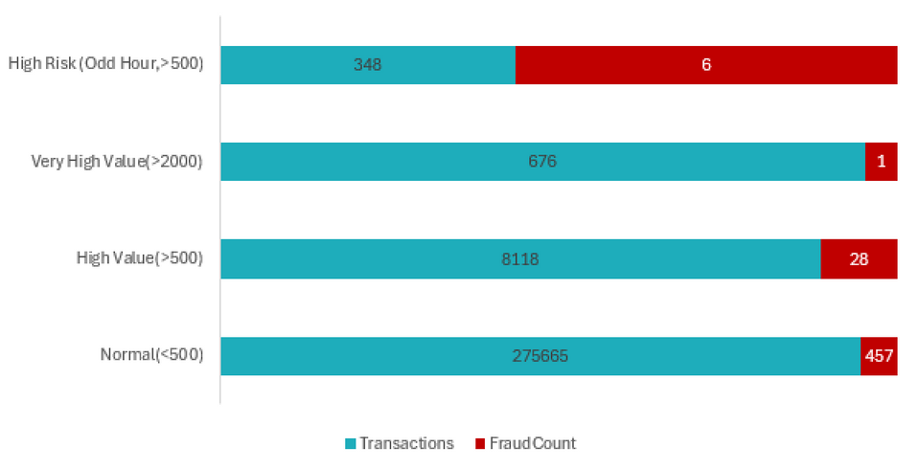
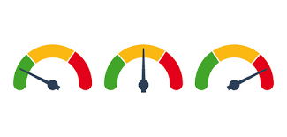
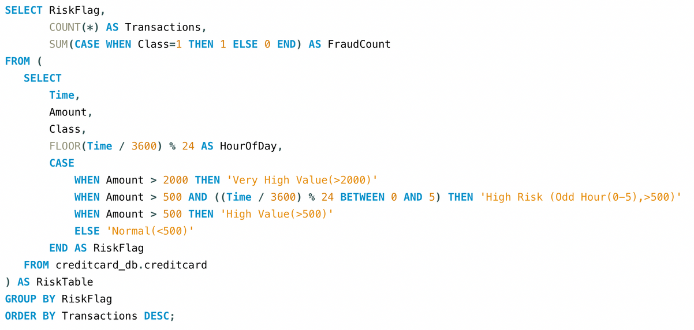
Risk Flag Patterns
6
Most frauds happen in the Normal (<500) group, with 457 frauds, because this group has the highest number of transactions.
The High Value (>500) group has fewer transactions (8,118) but still shows 28 frauds, which is noticeable.
The Very High Value (>2000) group has very few transactions (676) and only 1 fraud, so fraud is rare there.
The High Risk (Odd hours 0–5, >500) group is very small (348 transactions) but has 6 frauds, making it much riskier compared to its size.
Most frauds come from normal transactions, but odd-hour high-value transactions are the riskiest and need the most attention.

Slide 10
Conclusion
Fraudulent transactions may look like a small percentage of total volume, but their impact is high due to unusual timing and larger amounts.
By combining SQL analysis and visual patterns (trends, heatmaps, box plots), we can:
Detect fraud faster
Identify suspicious time windows
Build better preventive measures for financial security.

